Slide 1

UNIVERSITY OF TEXAS AT DALLAS
COMPUTER ARCHITECTURE (CE 6304.001)
Project Done on: OPTIMIZATION OF CACHE
Team Members:
Abhishek Mahesh Kumar AXM200255
Gokul Sai Raghunath GXR200021

Slide 2
OBJECTIVE:
To fine-tune the cache hierarchy on X86 architecture based on the gem5 simulator

Slide 3
INTRODUCTION TO CACHES
Some data is stored on the processor in a structure called CACHE to circumvent the delay of DRAM technology.
It makes use of SRAM, which is faster than DRAM but has a lower bit density.
On-chip memory is another name for cache.

Slide 4
ACCESSING GEM5
GEM5 was accessed using the server (ce6304.utdallas.edu)
PuTTY was used to connect to the Host using the SSH connection type.
We can access to the directory by giving the information requested by the directory.
The gem5 simulator is found in /usr/local/gem5, which can be copied to your home directory or local directory.
After adding GEM5 we can build scons with the following command:
% scons build/X86/gem5.opt

Slide 5
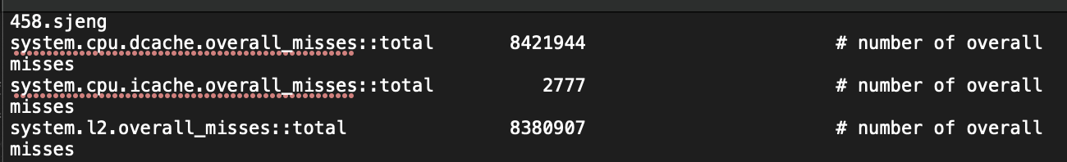
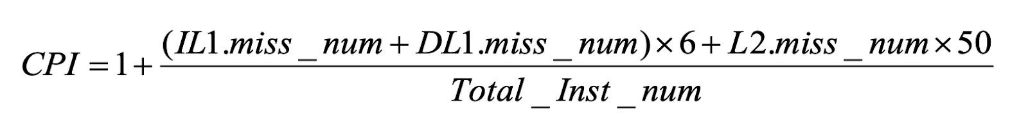
CPI FOR 458.SJENG BENCHMARK
CPI = 1 + [( 8421944 + 2777 ) * 6 + ( 8380907 * 50 )] / 50000000
CPI = 1.939187352

Slide 6
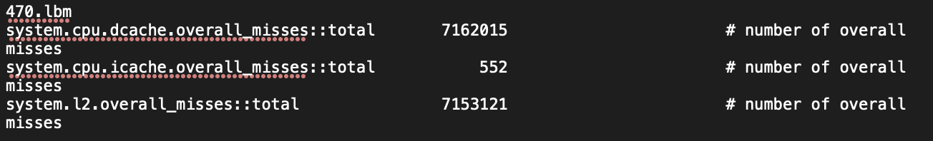
CPI FOR 470.LBM BENCHMARK
CPI = 1 + [(7162015 + 552)*6 + (7153121 * 50)]/50000000
CPI = 1.801262904

Slide 7
OPTIMIZING CPI
For both benchmarks, we are optimizing CPI by experimenting with different configurations of L1, L2 caches, cache line size, and cache associativity( 458.sjeng and 470.lbm).
LIMITATIONS:
Separate L1 cache with a maximum size of 256KB.
1MB unified L2 cache.

Slide 8
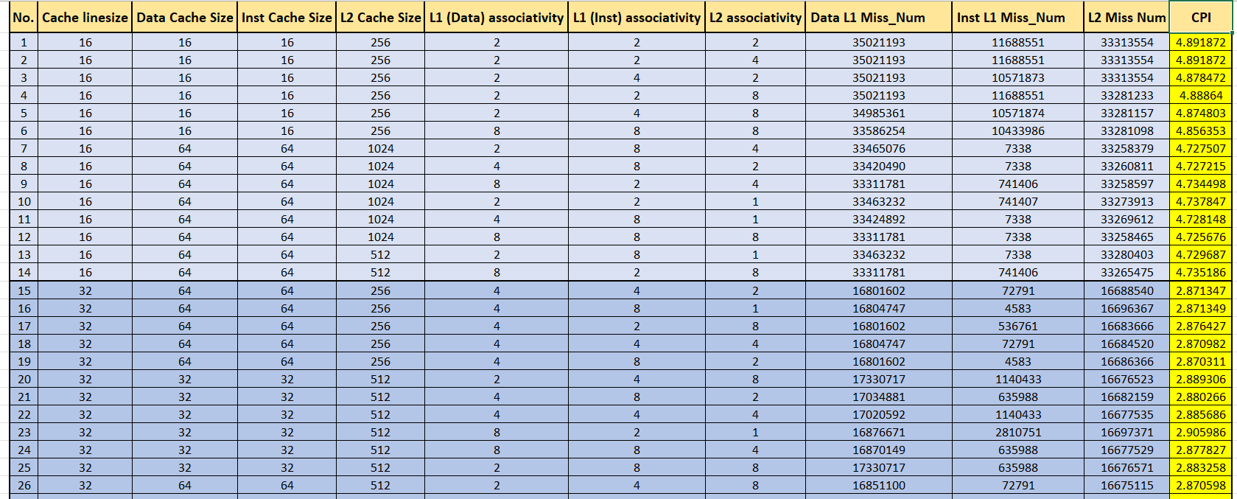
VARIOUS COMBINATIONS FOR 458.sjeng

Slide 9
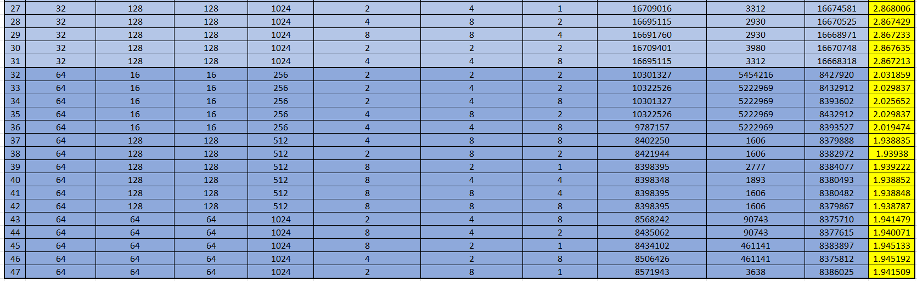
VARIOUS COMBINATIONS FOR 458.sjeng

Slide 10
VARIOUS COMBINATIONS FOR 458.sjeng
Scale:
Y axis = CPI
X axis = Index Number

Slide 11
VARIOUS COMBINATIONS FOR 458.sjeng
Scale:
Y axis = CPI
X axis = Index Number

Slide 12
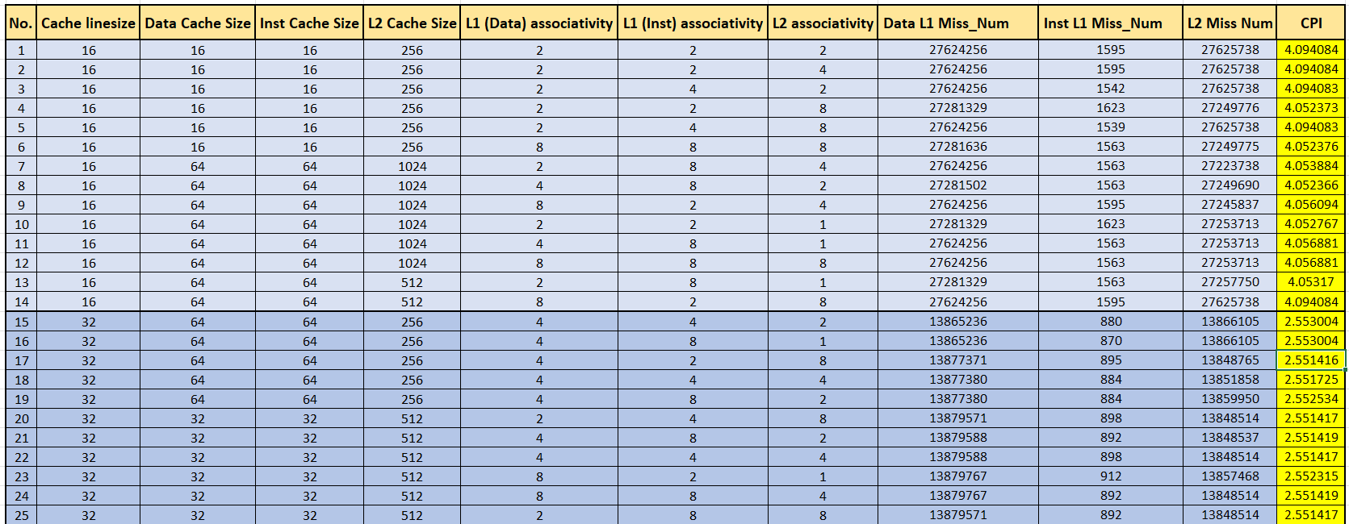
VARIOUS COMBINATIONS FOR 470.lbm

Slide 13
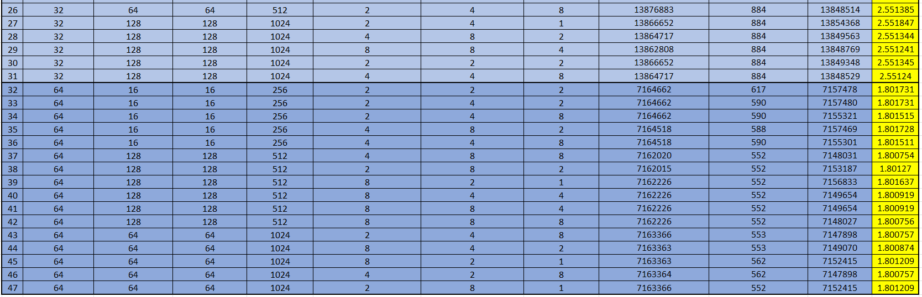
VARIOUS COMBINATIONS FOR 470.lbm

Slide 14
VARIOUS COMBINATIONS FOR 470.lbm
VARIOUS COMBINATIONS FOR 470.lbm
Scale:
Y axis = CPI
X axis = Index Number

Slide 15
VARIOUS COMBINATIONS FOR 470.lbm
Scale:
Y axis = CPI
X axis = Index Number

Slide 16
OBSERVATION
The CPI for both benchmarks drops significantly as the cache line size grows. This is due to the fact that increasing the line length will take advantage of spatial locality and increase the hit rate.
We see a decrease in CPI as associativity increases for small cache line sizes.
Cache line size =64 KB, D L1 cache size = 128KB, I L1 cache size = 128KB, L2 cache size = 512KB with D L1 associativity = 8 and I L1 associativity = 8, L2 associativity = 8 is optimum for 458.sjeng benchmark.
Cache line size =64 KB, D L1 cache size = 128KB, I L1 cache size = 128KB, L2 cache size = 512KB with D L1 associativity = 4 and I L1 associativity = 8, L2 associativity = 8 is optimum for 470.lbm benchmark.

Slide 17
COST FUNCTION
Let's have a look at some random costs, as listed below:
CACHE LINE COST:
16 KB cache line = 16 units
32 KB cache line = 32 units
64 KB cache line = 64 units
Cost doubles as cache line size doubles.
MAIN CACHE COST:
D L1 cost = 8 units
I L1 cost = 8 units
L2 cost = 6 units
L2 cache is cheaper than L1 cache as it is slower.

Slide 18
COST FUNCTION
ASSOCIATIVITY COST:
D L1 associativity cost = 4 units
I L1 associativity cost = 4 units
L2 associativity cost = 2 units
TOTAL COST = CACHE LINE COST + MAIN CACHE COST + ASSOCIATIVITY COST

Slide 19
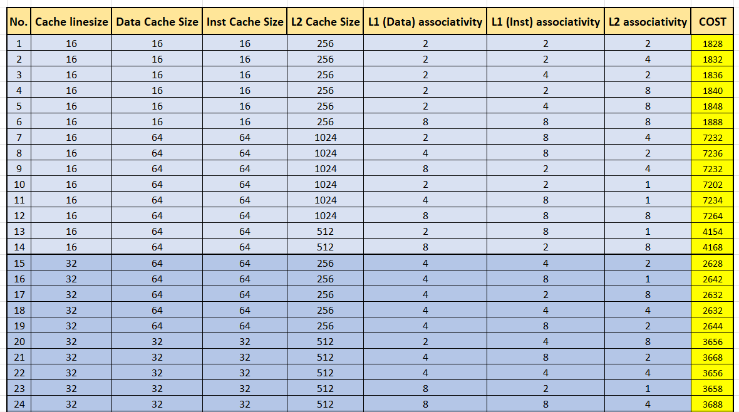
COST FOR DIFFERENT COMBINATIONS

Slide 20
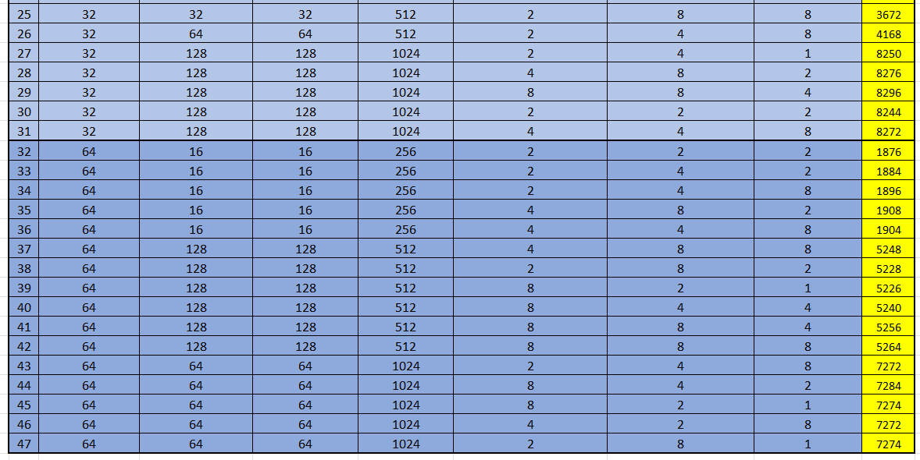
COST FOR DIFFERENT COMBINATIONS

Slide 21
OPTIMIZING CACHES FOR PERFORMANCE / COST (458.sjeng)
Scale:
X axis = CPI
Y axis = Cost

Slide 22
OPTIMIZING CACHES FOR PERFORMANCE / COST (458.sjeng)
Scale:
X axis = CPI
Y axis = Cost

Slide 23
OPTIMIZING CACHES FOR PERFORMANCE / COST (470.lbm)
Scale:
X axis = CPI
Y axis = Cost

Slide 24
OPTIMIZING CACHES FOR PERFORMANCE / COST (470.lbm)
Scale:
X axis = CPI
Y axis = Cost

Slide 25
CONCLUSION
We can see from the graphs that as CPI falls, the cost of the cache rises since the hardware cost rises.
Cache line size =64 KB, D L1 cache size = 128KB, I L1 cache size = 128KB, L2 cache size = 512KB with D L1 associativity = 8 and I L1 associativity = 8, L2 associativity = 8 is optimum for 458.sjeng benchmark.
Cache line size =64 KB, D L1 cache size = 128KB, I L1 cache size = 128KB, L2 cache size = 512KB with D L1 associativity = 4 and I L1 associativity = 8, L2 associativity = 8 is optimum for 470.lbm benchmark.

